Slide 1
)
EPF Withdrawal Form and Process Claims Online & Offline

Slide 2
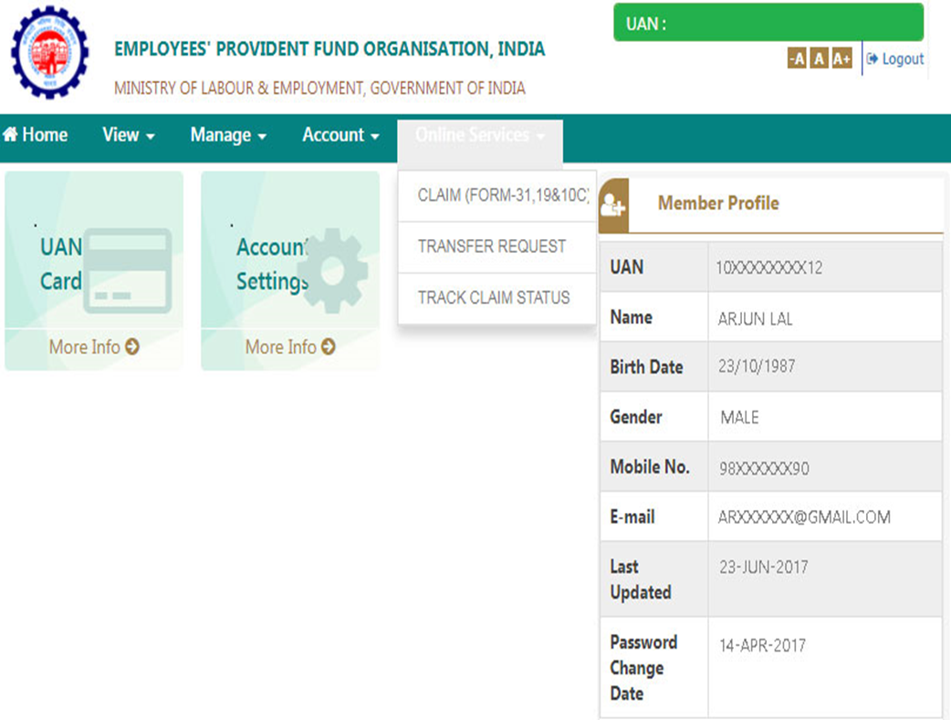
EPF Withdrawal Form and Process Claims Online & Offline
This is applicable to Un-exempted Employees – Employees part of the code 18734, 18453 and 32271
1
Step 1- Sign in to the UAN Member Portal with your UAN and Password.
Step 2- From the top menu bar, click on the ‘Online Services’ tab and select ‘Claim (Form-31, 19 & 10C)’ from drop down menu.

Slide 3
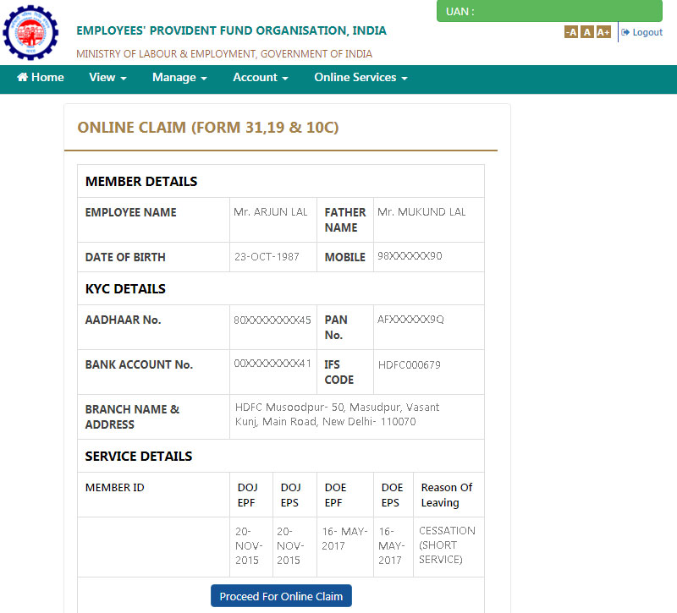
Step 3 – The next page will show Member Details, KYC Details and Service Details. Click the ‘Proceed for Online Claim’ button.

Slide 4
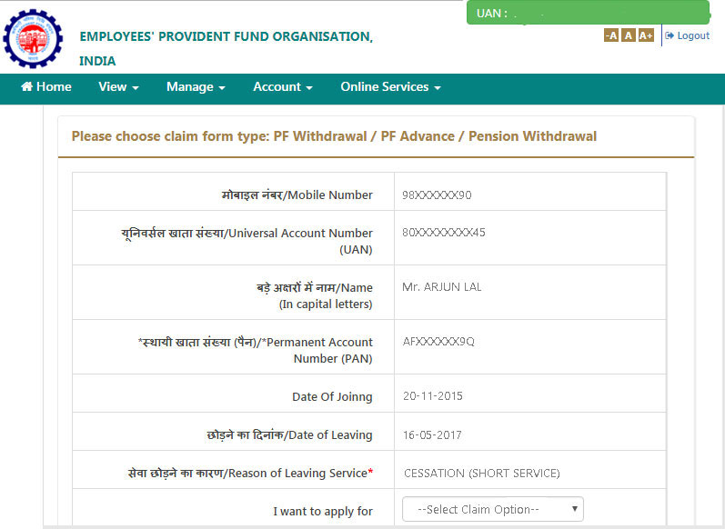
Step 4 – You will be redirected to the Claims Section. Here you will find more details such as PAN, Mobile Number, UAN, etc. Choose the type of claim- withdraw PF only or withdraw pension only.

Slide 5
Step 5 – Fill out the claim form carefully. Once completed, an OTP will be sent to your registered mobile number which, when entered in the form, will initiate the withdrawal claim. When the claim form is successfully submitted, an SMS notification will be sent to your registered mobile number. Once the claim is processed, the amount will be transferred into your bank account.
EPF Withdrawal Forms
At the time of filing an online withdrawal claim, you will find two options-
Only PF Withdrawal- Form 19
Only Pension Withdrawal- Form 10C

Slide 6
1- Form 19
This form is be filled to withdraw the entire accumulated PF amount which is also known as ‘final settlement’. You need to fill your personal details and employment details such as your date of leaving, reason of leaving services, date of joining services, PAN, UAN and Aadhaar Number, bank account details, full postal address, etc.
2- Form 10C
If you want to withdraw only the Pension amount, Form 10C should be filled. The fields in this form are similar to that in Form 19. The Pension amount is regulated by the Employee Pension Scheme, 1950 whereas the PF amount is regulated by the Employee Provident Fund Scheme, 1952. So even if you want to withdraw both the amounts, you will have to fill the two forms separately.

Slide 7
Points to Remember before Making PF Withdrawal Claim Online
You can claim your PF online only if you meet the following conditions -
• You must be allotted a UAN number and it should be activated
• Your mobile number must be registered with the UAN
• Your bank details must be seeded into the UAN
• Your PAN and Aadhaar should be seeded into the EPFO Database
Benefits of Claiming EPF Online
Making an online EPF withdrawal claim offers a number of benefits, such as -
Hassle-free Withdrawal- Online claim saves you from the hassle of visiting the PF office in person and standing in long queues. You just need to fill the forms online from the comfort of your home.
Reduced Processing Time- With online claims, the amount will be processed and credited into your bank account within 15-20 days of the application. The government plans to further reduce the processing.
No need to visit previous employer for verification- Unlike offline claim wherein you have to get your documents attested by the employer, online claims verification is done automatically. This is especially helpful for people who have moved to a new city as it will save them from the trouble of mailing the documents or travelling long distances.

